Slide 1




$$y$$
$$x$$
$$y=sign\left(w^{⊤}x+b\right)$$
$$y=w^{⊤}x+b$$
Linear Models

Slide 2



It does not seem any linear model can ever do well on these tasks, no matter how carefully we learn that model
You are right; to solve such learning problems, an entirely new class of models is needed
$$y$$
?
?
$$x$$
$$y=sign\left(w^{⊤}x+b\right)$$
$$y=w^{⊤}x+b$$
Non-linear Models

Slide 3
non-linear models
stepping out of line seems to be the key to ML’s success

Slide 4


Linear Functions
A function $f:ℝ^{d}→ℝ$ is called linear if it satisfies two properties
(Additivity) For any two vectors $x,y∈ℝ^{d}$, $f\left(x+y\right)=f\left(x\right)+f\left(y\right)$
(Homogeneity) For any vector $x∈ℝ^{d}$ and scalar $c∈ℝ$, $f\left(c⋅x\right)=c⋅f\left(x\right)$
Claim: Every linear function $f:ℝ^{d}→ℝ$ is of the form $f\left(x\right)=w^{⊤}x$ for some fixed vector $w∈ℝ^{d}$
Proof: Consider the standard basis vector $e_{i}≝\left[0,…0,1,0,…,0\right]$ for $i=1,…,d$ and consider $c≝\left[c_{1},…,c_{d}\right]$ where $c_{i}≝f\left(e_{i}\right)$. Using the two properties of linear functions, for any $x=\left[x_{1},…,x_{d}\right]∈ℝ^{d}$ $f\left(x\right)=f\left(\sum_{i=1}^{d}{x_{i}⋅e_{i}}\right)=\sum_{i=1}^{d}{x_{i}⋅f\left(e_{i}\right)}=\sum_{i=1}^{d}{x_{i}⋅c_{i}}=c^{⊤}x$
$i$-th coordinate

Slide 5

Exercise
Show that every linear function $f:ℝ^{d}→ℝ$ satisfies $f\left(0\right)=0$
Consider polynomials $f:ℝ→ℝ$ of the form $f\left(x\right)=x^{p}+b$ where $x,b∈ℝ,p∈ℕ$. For what values of $p,b$ can $f$ be a linear function?
Show that every function $f:ℝ^{d}→ℝ$ that is linear is convex too!
Is the converse true? Is every convex function linear too?
Recall the $L_{p}$ norms of the form ${\left\|x\right\|}_{p}≝{\left({\left|x_{1}\right|}^{p}+…+{\left|x_{d}\right|}^{p}\right)}^{\frac{1}{p}}$. Are $L_{p}$ norms linear for any value of $p∈ℕ$? If not, which property of linear functions (additivity or homogeneity) do they violate?

Slide 6





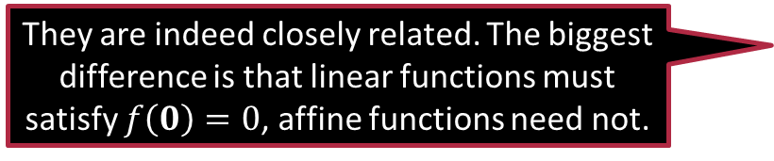

Affine Functions
A function $g:ℝ^{d}→ℝ$ is called affine if we can write $g$ as $g\left(x\right)= f\left(x\right)+b$ for some linear function $f$ and $b∈ℝ$
$$w^{⊤}x$$
Exactly. When someone says they are using a non-linear model, they usually mean a model that is both non-linear and non-affine
Yup! If we use a linear function as a binary classifier, its decision boundary will always pass through the origin
They are indeed closely related. The biggest difference is that linear functions must satisfy $f\left(0\right)=0$, affine functions need not.
$$y$$
$$w$$
When ML people use the term “linear model” they are usually talking about an affine function ☺
What is the difference between affine and linear functions? They both seem to be quite similar!
$$x$$

Slide 7


Linear and Affine Maps
Linear maps: linear functions of the form $f:ℝ^{d}→ℝ^{e}$
$f\left(x+y\right)=f\left(x\right)+f\left(y\right)$ and $f\left(c⋅x\right)=c⋅f\left(x\right)$ for all $x,y∈ℝ^{d},c∈ℝ$
Affine maps: affine functions of the form $g:ℝ^{d}→ℝ^{e}$
Claim: Linear maps must be of the form $f\left(x\right)=Ax$ for some fixed matrix $A∈ℝ^{e×d}$
Proof: Left as an exercise ☺
Hint: Look at how $f$ acts on the standard basis vectors of the input space i.e., $e_{i}∈ℝ^{d}$ and use additivity and homogeneity properties as before
Corollary: Affine maps must be of the form $g\left(x\right)=Ax+b$ for some fixed matrix $A∈ℝ^{e×d}$ and fixed vector $b∈ℝ^{e}$
The terms function and map are used interchangeably. The term map is often used to emphasize the fact that a function’s outputs are vectors and not scalars

Slide 8

Exercise
Are constant functions $f\left(x\right)≡c$ affine? Are they always linear?
Show that a function/map $f:ℝ^{d}→ℝ^{e}$ is affine iff (if-and-only-if) there exists a linear map $g:ℝ^{d}→ℝ^{e}$, such that for all $x,y∈ℝ^{d}$ $f\left(x\right)−f\left(y\right)=g\left(x−y\right)$
Affine functions preserve convexity. Specifically, if $f:ℝ^{d}→ℝ^{e}$ is an affine function and $𝒞⊂ℝ^{d}$ is a convex set, then show that the set $f\left(𝒞\right)≝\left\{f\left(x\right):x∈𝒞\right\}⊂ℝ^{e}$ is convex too!
Is the converse true? If a function preserves convexity (it maps all convex sets to convex sets), must it necessarily be affine?
This problem is trickier to solve – do not feel discouraged if you get stuck!

Slide 9


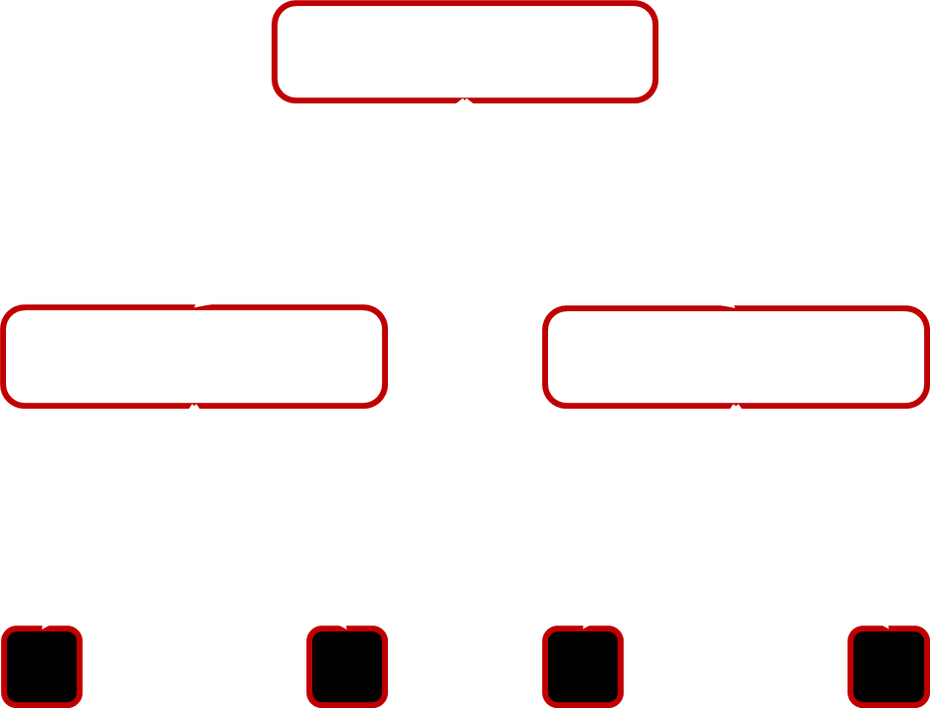
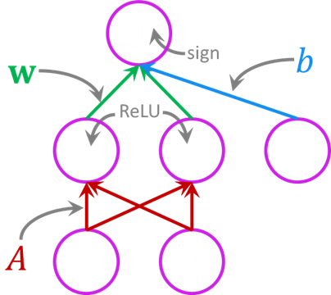
Opening the door to non-linearity
State-of-the-art, commercial, web-scale models often combine the two techniques e.g., use nearest neighbor on top of new features learnt using neural networks
Reduce the problem to linear models
Use a combination of multiple linear models instead of a single linear model
Examples: decision trees, learning with prototypes, nearest neighbors
Reduce the problem to linear models
Modify the features and learn a single linear model over the new features
Examples: neural networks, kernel methods

Slide 10

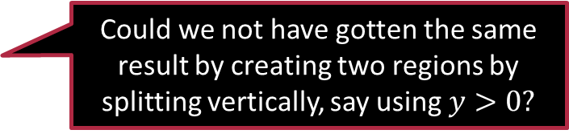





Decision Trees
Indeed, you could have. Several possible decision trees could exist for the same task
$$y$$
root
$$x>0?$$
2
right-child of the root
YES
NO
1
left-child of the root
0
$$x$$
$$y>0?$$
$$y<0?$$
-1
-2
YES
NO
YES
NO
leaf
leaf
leaf
-2 -1 0 1 2
Could we not have gotten the same result by creating two regions by splitting vertically, say using $y>0?$

Slide 11













Decision Trees
$$x=\left(x,y\right)$$
$$u=\left(+1,0\right) \\ v=\left(0,+1\right) \\ w=(0,−1)$$
Usually we learn layer-by-layer, first the root model, then the models for its children and so on
We will study algorithms to learn DT later. However, note that DT learning is an intractable (NP-hard) problem
$$y$$
$$sign\left(u^{⊤}x\right)$$
2
$$+1$$
$$−1$$
1
0
$$x$$
$$sign\left(v^{⊤}x\right)$$
$$sign\left(w^{⊤}x\right)$$
-1
-2
$$+1$$
$$−1$$
$$+1$$
$$−1$$
-2 -1 0 1 2
How does one learn all these multiple linear models? Do we learn them together or one after another? How do we decide how many layers to have?
The number of layers needs to be tuned as a hyperparameter

Slide 12













Regression Trees
Decision trees for regression problems are often called regression trees
$$y$$
root
$$sign\left(ux+a \right)$$
4
$$x>1?$$
3
$$+1$$
$$−1$$
YES
NO
leaf
2
leaf
$$vx+b$$
$$wx+c$$
1
$$x−0.5$$
$$1.5−x$$
0
$$x$$
$$u=1,a=−1 \\ v=1,b=−0.5 \\ w=−1,c=1.5$$
-3 -2 -1 0 1 2 3 4 5
Notice that since this decision tree is solving a regression problem, the leaves each contain a regression model
Notice that this regression tree cleverly used linear models for classification as well as regression to solve a non-linear regression problem!

Slide 13















Neural Networks
When an NN fails, it could either be that its parameter values (in this case $A,w,b$ ) were not good or there may be a deeper (pun intended) problem with the architecture of the NN itself
$$A=\left[\begin{matrix}0 & 1 \\ 1 & 0\end{matrix}\right] \\ w=\left(1,−1\right),b=−0.5$$
$$y$$
2
$$sign\left(w^{⊤}\max\left(Ax,0\right)+b\right)$$
$$sign\left(w^{⊤}φ\left(x\right)+b\right)$$
1
sign
$$b$$
$$w$$
0
$$x$$
ReLU
$$φ$$
1
-1
-2
$$x$$
$$A$$
$$x$$
$$y$$
-2 -1 0 1 2
“Didn't work, did it?”
-- Maggie Smith, 2002 (as recounted by Ian McKellen)
ReLU activation
$$φ\left(x\right)=\max\left(Ax,0\right)$$

Slide 14



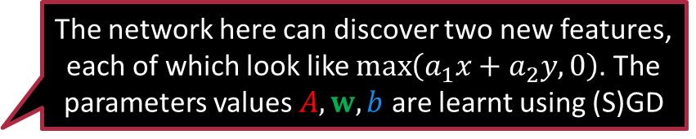
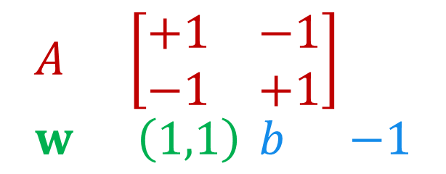

Neural Networks
The network here can discover two new features, each of which look like $\max\left(a_{1}x+a_{2}y,0\right)$. The parameters values $A,w,b$ are learnt using (S)GD
The design of the neural network, number of layers, number of nodes in each layer, activation functions, decide what sort of features that NN can discover
$$A=\left[\begin{matrix}+1 & −1 \\ −1 & +1\end{matrix}\right] \\ w=\left(1,1\right),b=−1$$
$$y$$
These features were able to solve this task but may not work for some other task. Learning the optimal neural network is also an NP-hard problem ☺☹😐
2
$$sign\left(w^{⊤}\max\left(Ax,0\right)+b\right)$$
1
sign
$$b$$
$$w$$
0
$$x$$
ReLU
$$φ$$
1
-1
-2
$$x$$
$$A$$
$$x$$
$$y$$
-2 -1 0 1 2
ReLU activation
I have so many questions. How did we choose these features that did well, how are $A,w,b$ learnt?
$$φ\left(x\right)=\max\left(Ax,0\right)$$

Slide 15


Neural Networks
$$A=\left[\begin{matrix}+1 & −1 \\ −1 & +1\end{matrix}\right] \\ w=\left(1,1\right),b=−1$$
Notice that the NN learnt a very different decision boundary than the DT
$$\max\left(t,0\right)+\max\left(−t,0\right)=\left|t\right|$$
$$y$$
2
$$sign\left(\max\left(x−y,0\right)+\max\left(y−x,0\right)−1\right)$$
$$sign\left(\left|x−y\right|−1\right)$$
$$sign\left(w^{⊤}\max\left(Ax,0\right)+b\right)$$
1
sign
$$b$$
$$w$$
0
$$x$$
ReLU
$$φ$$
1
-1
-2
$$x$$
$$A$$
$$x$$
$$y$$
-2 -1 0 1 2
ReLU activation
$$φ\left(x\right)=\max\left(Ax,0\right)$$

Slide 16



Exercises
$$y$$
Note that the classifier $sign\left(\left|x+y\right|−1\right)$ will also solve this problem. Can you find model parameter values for $A,w,b$ for the previous neural network that will yield this classifier?
2
1
0
$$x$$
-1
-2
-2 -1 0 1 2

Slide 17










Neural Networks
Note that this neural network creates two new features even though the data point had only one feature to begin with
$$y$$
No final activation
4
$$w^{⊤}φ\left(x\right)+b$$
3
$$w$$
$$b$$
2
ReLU
$$φ$$
1
1
0
$$x$$
$$x$$
$$a$$
$$x$$
$$1$$
$$c$$
-3 -2 -1 0 1 2 3 4 5
ReLU activation
$$φ\left(x\right)= \max\left(x⋅a+c,0\right)$$

Slide 18




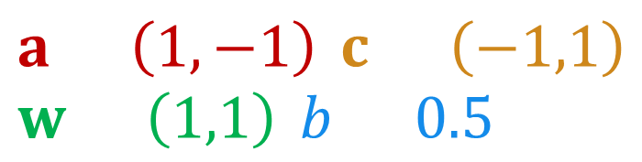


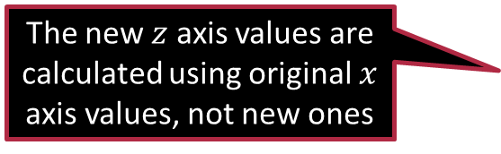


Neural Networks
$$a=\left(1,−1\right),c=\left(−1,1\right) \\ w=\left(1,1\right),b=0.5$$
3
The new $z$ axis values are calculated using original $x$ axis values, not new ones
$$y$$
0
2
1
1
2
No final activation
0
3
$$w^{⊤}φ\left(x\right)+b$$
-1
4
-2
-3
5
$$w$$
$$b$$
4
ReLU
3
$$φ$$
1
2
1
$$x$$
$$a$$
$$x$$
$$1$$
$$c$$
0
$$x$$
new $x$-axis
new $z$-axis
$$z$$
$$\left(\max\left(x−1,0\right),\max\left(1−x,0\right)\right)$$
$$φ\left(x\right)= \max\left(x⋅a+c,0\right)$$

Slide 19

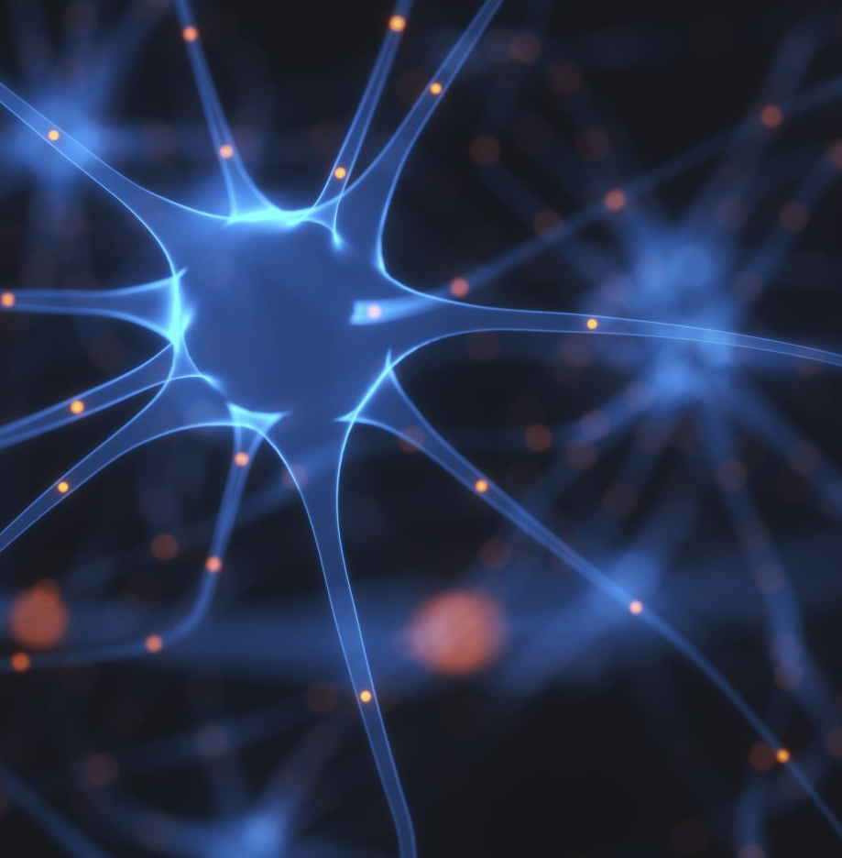

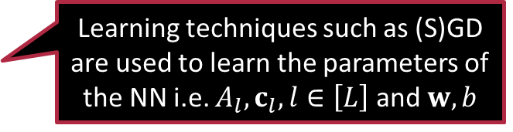
Non-linearity in Neural Networks
Activation functions are often applied coordinate -wise
Such deep stacking of layers allows NNs to learn very powerful features on top of which a linear can do well
The simplest features learnt by NNs look like $φ\left(x\right)=σ\left(Ax+c\right)$
where $x∈ℝ^{d},A∈ℝ^{e×d},c∈ℝ^{e}$
$σ:ℝ→ℝ$ is an activation function
Examples: ReLU, GeLU, sigmoid, tanh
NNs often stack such feature learners $φ_{1}\left(x\right)=σ\left(A_{1}x+c_{1}\right)$ $φ_{2}\left(x\right)=σ\left(A_{2}φ_{1}\left(x\right)+c_{2}\right)$ $φ_{3}\left(x\right)=σ\left(A_{3}φ_{2}\left(x\right)+c_{3}\right)$ $…$ $…$ $y=sign\left(w^{⊤}φ_{L}\left(x\right)+b\right)$
Crucial: $σ$ must be a non-linear function
NNs cannot learn a non-linear model if $σ$ is linear
Learning techniques such as (S)GD are used to learn the parameters of the NN i.e. $A_{l},c_{l},l∈\left[L\right]$ and $w,b$

Slide 20

Exercises
Recall that ML folks often use the terms linear and affine interchangeably
Consider a neural network that uses a linear activation function $y=sign\left(w^{⊤}σ\left(Ax+c\right)+b\right)$ $x∈ℝ^{d},A∈ℝ^{e×d},c∈ℝ^{e},w∈ℝ^{e},b∈ℝ$ and $σ\left(t\right)=p⋅t+q$ is a linear activation function for some $p,q∈ℝ$. Show that this NN can only learn linear classifiers i.e., there exist $u∈ℝ^{d},v∈ℝ$ (the values of $u,v$ depend only on the values of $A,c,w,b,p,q$) s.t. $sign\left(w^{⊤}σ\left(Ax+c\right)+b\right)=sign\left(u^{⊤}x+v\right)$
Consider a NN that uses quadratic activation function $σ\left(t\right)=t^{2}$ $y=w⋅σ\left(a⋅x+c\right)+b$ where $x,a,c,w,b∈ℝ$. What types of functions can this NN learn?

Slide 21



Exercises
$$x=−y$$
$$x=y$$
Create a feature map $φ:ℝ^{2}→ℝ^{D}$ for some $D>0$ so that for any $z=\left(x,y\right)∈ℝ^{2}$, $sign\left(1^{⊤}φ\left(z\right)\right)$ takes value $+1$if $z$ is in the blue region and $−1$ if $z$ is in the yellow region. $1=\left(1,1,…,1\right)∈ℝ^{D}$is the $D$-dimensional all-ones vector. The dashed lines in the figure are $x=y$and $x=−y$.

Slide 22



Exercises
For a circle with centre $c=\left(p,q\right)∈ℝ^{2}$ and radius $r>0$, lets build a classifier that gives label $−1$ if a point $x=\left(x,y\right)∈ℝ^{2}$ is inside the circle i.e., in the yellow region and $+1$ otherwise. Give a feature map $φ:ℝ^{2}→ℝ^{D}$ for some $D>0$ and a corresponding linear classifier$W∈ℝ^{D}$ such that for any $x∈ℝ^{2}$, $sign\left(W^{⊤}φ\left(x\right)\right)$ is the correct output. The map $φ$ must not depend on $p,q,r$ but the classifier $W$ may depend on $p,q,r$.
$$\left(p,q\right)$$
$$r$$

Slide 23



Exercises
For a 2D rectangular hyperbola with equation $xy=c^{2}$ for $c∈ℝ$, give a feature map $φ:ℝ^{2}→ℝ^{D}$ for some $D>0$ and a corresponding linear classifier $W∈ℝ^{D}$ so that for any $x∈ℝ^{2}$, $sign\left(W^{⊤}φ\left(x\right)\right)$ takes value $z=−1$ in the yellow and $z=+1$ in the blue region. The map $φ$ must not depend on $c$ but $W$ may depend on $c$.
$$\left(c,c\right)$$
$$\left(−c,−c\right)$$

Slide 24
Summary
Linear and affine functions have simple and easy-to-understand structure that makes it easy to learn linear models e.g. SVMs
Several real-life applications require non-linear models to be learnt
ML uses clever tricks to reduce the problem of learning non-linear models to the problem of learning linear models
Learning a combination of several linear models (decision/regression trees)
Learning modified features over which a linear model does well (NN)
Learning non-linear models often turns out to be an NP-hard task
Learning an optimal DT or optimal NN are both NP-hard problems
Nevertheless, several heuristics exist that allow us to learn reasonably accurate DTs and NNs for real-world problems in reasonable time

Slide 25
Stay Classy!
Catch-up with you next time

